Slide 1
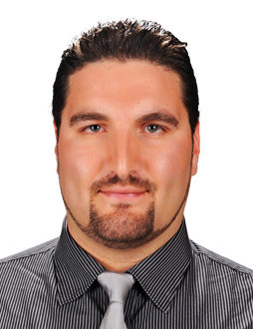
SUMMER TRAINING for SUMMER 2025
Bilkent University
Faculty of Engineering
Prof. Barbaros Çetin, Assoc. Dean

Slide 2
Summer Training Process
The Summer Training application process for engineering students are administered by the Dean’s Office of Faculty of Engineering
Location: Room 225 of EA Building, 2nd floor
Phone: 290-1261, 290-2354
Website: mf.bilkent.edu.tr
Ms. Gizem Ballı & Mr. İlkan Sara are the administrative assistants assigned to Summer training, you can reach them through e-mail at mfstaj@bilkent.edu.tr
Summer Training application process is run through online Summer Training System (STS).
See STS Instructions on the website:
mf.bilkent.edu.tr → For Students → Summer Training

Slide 3
Summer Training Rules
An Engineering student needs to complete two mandatory summer trainings:
(1) in the Summer just after the 2nd curriculum year
(2) in the Summer just after the 3rd curriculum year
The training duration must be at least 20 working days (Monday thru Friday)
These 20 working days must be consecutive (except intervening holidays).
According to the Social Security Law no. 5510, item 5b, each student doing Summer training in Türkiye needs to be insured for “work-related accidents and occupational diseases” during his/her 20 working days of summer training.
Without Social Security, a student CANNOT conduct summer training!!!
Bilkent University provides this insurance (free of charge) for both mandatory and volunteer summer training.

Slide 4
Prerequisites & Dept. Coordinators
Department | Prereq. for XX299 | Prereq. for XX399 | Department Coordinator
Computer Eng. | CS202 | CS299 | Shervin R. Arashloo Özgür S. Oğuz staj@cs.bilkent.edu.tr
Electrical & Electronics Eng: | EE102 & EE211 | EEE299 | Aykut Koç aykut.koc@bilkent.edu.tr Tolga Çukur cukur@ee.bilkent.edu.tr
Industrial Eng. | IE271 or IE272 | IE299 | Nil Şahin nilsahin@bilkent.edu.tr Özlem Çavuş ozlem.cavus@bilkent.edu.tr
Mechanical Eng. | ME211 & ME231 | ME212 & ME342 ME371 & ME381 | Kaan Bitirim kaan.bitirim@bilkent.edu.tr

Slide 5
Summer Training Arrangement
Each student is responsible for arranging with a company to do Summer Training on her/his own.
A list of approved companies, together with information like name, address, telephone number, etc., are available in STS.
If the company is not listed or listed but not approved on STS, the student should provide the required information for the company, then an approval process will follow.
Only the summer training coordinators can approve the companies on STS by checking the acceptance letter as well as the status of the company.
After deciding on and arranging with a company to do summer training, a student needs to get an acceptance letter from the company which must include the start date and end date of the summer training and with official letterhead, signed and stamped by a legally authorized executive of the company.
CAUTION: If the company is also operational on Saturday, this should be indicated explicitly in the acceptance letter!!!

Slide 6
Process
The student with a signed acceptance letter from a company (that is listed on STS), will first fill out a mandatory Summer Training Application Form on STS.
The Summer Training application needs to be completed at least two weeks before the starting date of the Summer training, i.e., two-week rule!!!
Once the application is approved, the insurance process will be initiated, and Summer Training documents for the student will be prepared.
CAUTION: If the insurance of the student will be covered by the company, this issue MUST be explicitly indicated in the acceptance letter.
Without Social Security, a student CANNOT conduct summer training!!!
Students can track the insurance process through E-Devlet system by searching "Sosyal Güvenlik Kurumu/4A İşe Giriş Çıkış Bildirgesi" and generate and download the relevant document required by the Employers.
Once the mentor for your Summer Training is assigned, fill out the required information of your mentor on STS!!!

Slide 7
Important Dates
A student can start her/his Summer Training after the Spring semester has ended. The earliest date for 2024 is 03-June- 2025.
A student must complete the Summer Training before the Fall semester begins
Deadline to start the application process: 11-August-2025
Deadline for the beginning of the Summer Training: 18-August-2025
Without Social Security, a student CANNOT conduct summer training!!!
As a general policy, when the training overlaps (even partially) with the Fall or Spring semesters and/or the 20 consecutive days requirement is not met, then the training will not be counted towards xx299 or xx399.
If a student is taking a course in the Spring semester that is a prerequisite for the summer training course, the Prerequisite status of the student will be "Not Stasfied" on STS. Following the announcement of the grades, the status would turn into "Satisfied". Should a student fail the prerequisite course, the student cannot conduct Mandatory Summer Training, but the student can still conduct Volunteer Summer Training.
The company name and the training dates processed on STS SHOULD NOT be changed since the insurance process might have already been initiated!!!

Slide 8
Important Notes
Face-to-face (on-site) Summer Training with companies is the default training type.
If face-to-face Summer Training is not possible, the student should contact Department Coordinators and verify the reason.
Summer Training abroad is possible:
Erasmus+ (app.erasmus.bilkent.edu.tr)
Departmental Agreements (as an example, CS and EEE have agreements with the Fraunhofer Institute Germany)
Students will receive information from their Departmental Coordinators:
Department-based policies
What to expect from summer training
Summer practice reports
Exceptional situations

Slide 9
State Contribution
A company may request State Contribution for the summer training of a student due to a possible payment processed to the student.
This can be requested from the State through the University.
For this, the company must fill out and send a form to the Dean’s Office after the training.
This form is available on the Faculty of Engineering website:
http://mf.bilkent.edu.tr → For Students/Summer Training/Company and Student Information Form for State Contribution
A student can download and give this form to the company during her/his training.

Slide 10
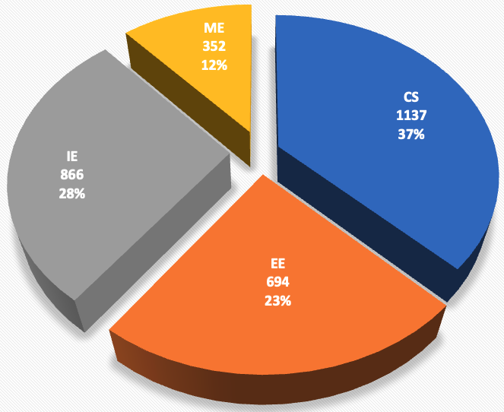
Frequently Asked Questions
# of Questions: ~3050

Slide 11
Frequently Asked Questions
For which time frame should we target for our Summer Training?
The earliest date for 2024: 03-June- 2025 (DO NOT FORGET two-week rule!!!)
Deadline to start the application process: 11-August-2025
Deadline for the beginning of the Summer Training: 18-August-2025
Whom should I contact for my questions related to Summer Training?
If you have questions related to the Summer Training application, insurance for work-related accidents and occupational diseases, documents to be signed by the Associate Dean, etc. you need to send an e-mail to mfstaj@bilkent.edu.tr and you SHOULD NOT be sending e-mails to individuals.
If your questions are related to what to expect from Summer Training, how to write the Summer Practice Report, or topics that require Departmental Approval (read this document carefully on these matters), etc. then you need to contact Department Summer Training Coordinators or Department Administrative Assistants.

Slide 12
Frequently Asked Questions
How can I contact the Administrative Assistants for matters regarding Summer Training applications?
The Dean’s office is the responsible party for your Summer Training. At the Dean’s office, the two following staff members are the administrative assistants assigned to Summer Training-related matters.
Ms. Gizem Ballı and Mr. İlkan Sara , both of whom will be responding to e-mails sent to mfstaj@bilkent.edu.tr.
Could we do mandatory Summer Training at our own department with a Faculty Member or at another University in Türkiye? Could we do mandatory Summer Training at a Research Center in Türkiye or at a University abroad?
On these matters, Departments have different strategies, please contact your Department Coordinator on this matter!
Could we do online (remote) Summer training?
As a general principle, students are expected to pursue on-site Summer Training at a company. However, the Departments may allow online Summer Training for Summer 2025 for certain cases.
An exception is ME299 which has a stringent requirement on on-site Summer training.

Slide 13
Frequently Asked Questions
Do I need to use the system for voluntary internships?
YES, and you should indicate that your training is a voluntary internship.
Whom should we contact regarding the Summer Training-related courses xx299 and xx399, prerequisites, Summer Practice reports, etc.?
You need to contact your Department Coordinators and/or Department Administrative Assistants.
Can I do two Summer Trainings within the same Summer?
We expect the students to have two Summer Trainings in two different Summer periods. The choice of the prerequisites also does not allow this possibility. However, such requests are occasionally approved by the Department Coordinators when there is a risk involved regarding the delay of the student's graduation.
If a student did two Summer Trainings in the same Summer (this can only be possible with the approval from the Department Coordinators), then she/he must register for both of the Summer Training courses in the following Fall semester and submit both of the reports.

Slide 14
Frequently Asked Questions
Can I delay taking (and also passing) the xx299 and xx399 courses arbitrarily?
NO, the students need to pass these courses within the next two semesters after completing the Summer training. As an example, when you complete the summer training in summer 2025, you need to register for the related course and pass in either the next Fall or Spring semesters. Otherwise, the Summer Training should be repeated!
What are the conditions to be satisfied for completing the xx299 and xx399 courses successfully?
The performance of the Student in the Summer Training needs to be indicated as successful in the Evaluation Form signed by the company. Moreover, the Summer Practice Report submitted by the Student needs to be approved by the Department after it is evaluated by a Faculty Member. When these two conditions are met, then the Student is deemed successful for the related course.

Slide 15
Frequently Asked Questions
I have an acceptance for Summer Training? Can I apply now?
NO. The application system will be operational by March 24, after which you may apply. If the company is not approved on STS, you may start to work towards its approval once the STS becomes operational.
How can I check the status of the insurance process?
In order to track the insurance process, the students will need to check this out at E-Devlet by searching "Sosyal Güvenlik Kurumu/4A İşe Giriş Çıkış Bildirgesi" and generate and download the relevant document required by the Employers.
What is the procedure for Voluntary Summer Training?
Those students who would like to conduct voluntary Summer Training can follow the same procedure, but there is no need to fill out the mentor information on STS and prepare a summer training report.

Slide 16
Frequently Asked Questions
Can I switch my Summer Training from Volunteer to Mandatory?
NO. For a mandatory Summer Training, the mentor of the student should provide an evaluation form, and the student should submit a Summer Training Report. The requirements for mandatory Summer Training are tighter than volunteer Summer training; therefore, switching Summer Training from volunteer to mandatory is not possible.
Can I switch my Summer Training from Mandatory to Volunteer?
YES. Since there is no requirement for mentor evaluation and submission of the Summer Training Report, switching a Summer training from mandatory to volunteer is possible.
Is there any exception to having Summer Training during a semester?
YES. For some reason, if you are not taking any course for a particular semester and if you satisfy the prerequisite of the Summer Training course, you can conduct your Summer Training during the semester.

